Slide 1
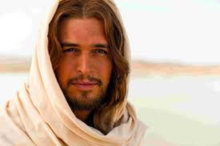
Staging the Passion on TV
Professor Helen K Bond, University of Edinburgh

Slide 2
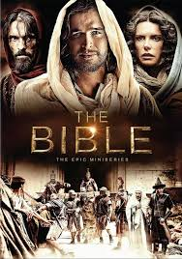

Slide 3
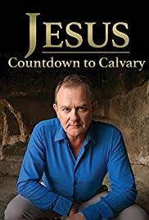
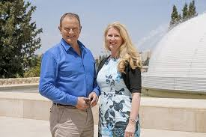

Slide 4
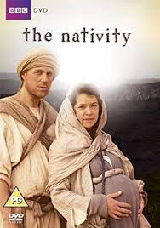
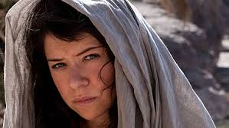

Slide 5
Challenge I: Differences between the accounts

Slide 6
Mark: Self-denial and a slave’s death
Jesus’ teaching in Mark concerns denying oneself
Jesus dies a slave’s death on the cross; miserable, pitiable end.
Alone, abandoned (apparently even by God)
Needs a series of prodigies and the resurrection to redeem it.

Slide 7
Matthew: A community in dispute with the Jewish synagogue
Theme of guilt for the death of Jesus runs through Matthew’s account.
Pilate’s wife’s dream.
Pilate washes his hands, says he’s innocent of Jesus’ blood.
‘All the (Jewish) people’ say ‘His blood be on us and on our children’

Slide 8
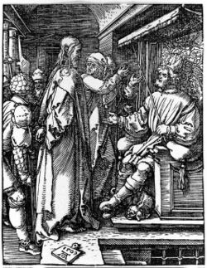
Luke: Christianity is perfectly compatible with Rome; innocence
More formal trial with specific charges
Pilate three times declares Jesus innocent
Trial before Herod Antipas (2 witnesses to his innocence)
Jesus dies forgiving enemies

Slide 9
John: lifting up the Son in Glory
Cross, resurrection and ascension all rolled together in John.
‘Lifting up’ – means by which people see the Father’s glory.
Jesus’ mother and Beloved Disciple at cross.
‘It is finished’

Slide 10
‘The Gospel Account’
Jesus is arrested
Brief interview before the High Priest
Longer trial before Jewish council
Condemned of blasphemy
Passed to Pontius Pilate
Sent to Herod Antipas
Pilate washes his hands, the people cry ‘his blood be on us and on our children’
Pilate sends Jesus to the cross

Slide 11
‘The Gospel Account’
Jesus is arrested
Brief interview before the High Priest (only Jn)
Longer trial before Jewish council (Mk, Mt)
Condemned of blasphemy (Mk, Mt)
Passed to Pontius Pilate
Sent to Herod Antipas (only in Luke)
Pilate washes his hands, the people cry ‘his blood be on us and on our children’ (only Mt)
Pilate sends Jesus to the cross

Slide 12
Challenge 2: Brevity

Slide 13
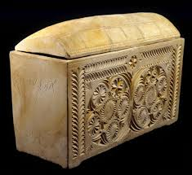
Historical Background

Slide 14
Clothing

Slide 15
Challenge 3: Anti-Jewishness

Slide 16
Opportunities?
Non-canonical literature
Acts of Pilate
Gospel of Peter
Letters from Pilate to the Emperor
Passion plays themselves
Always reinterpreting/ making relevant

